Slide 1



SP
Project Presentation
Hotel Booking Management System
Presented By:
Group No-IX
Guided By:
Mrs. Roopa

Slide 2

HOTEL BOOKING MANAGEMENT SYSTEM

Slide 3
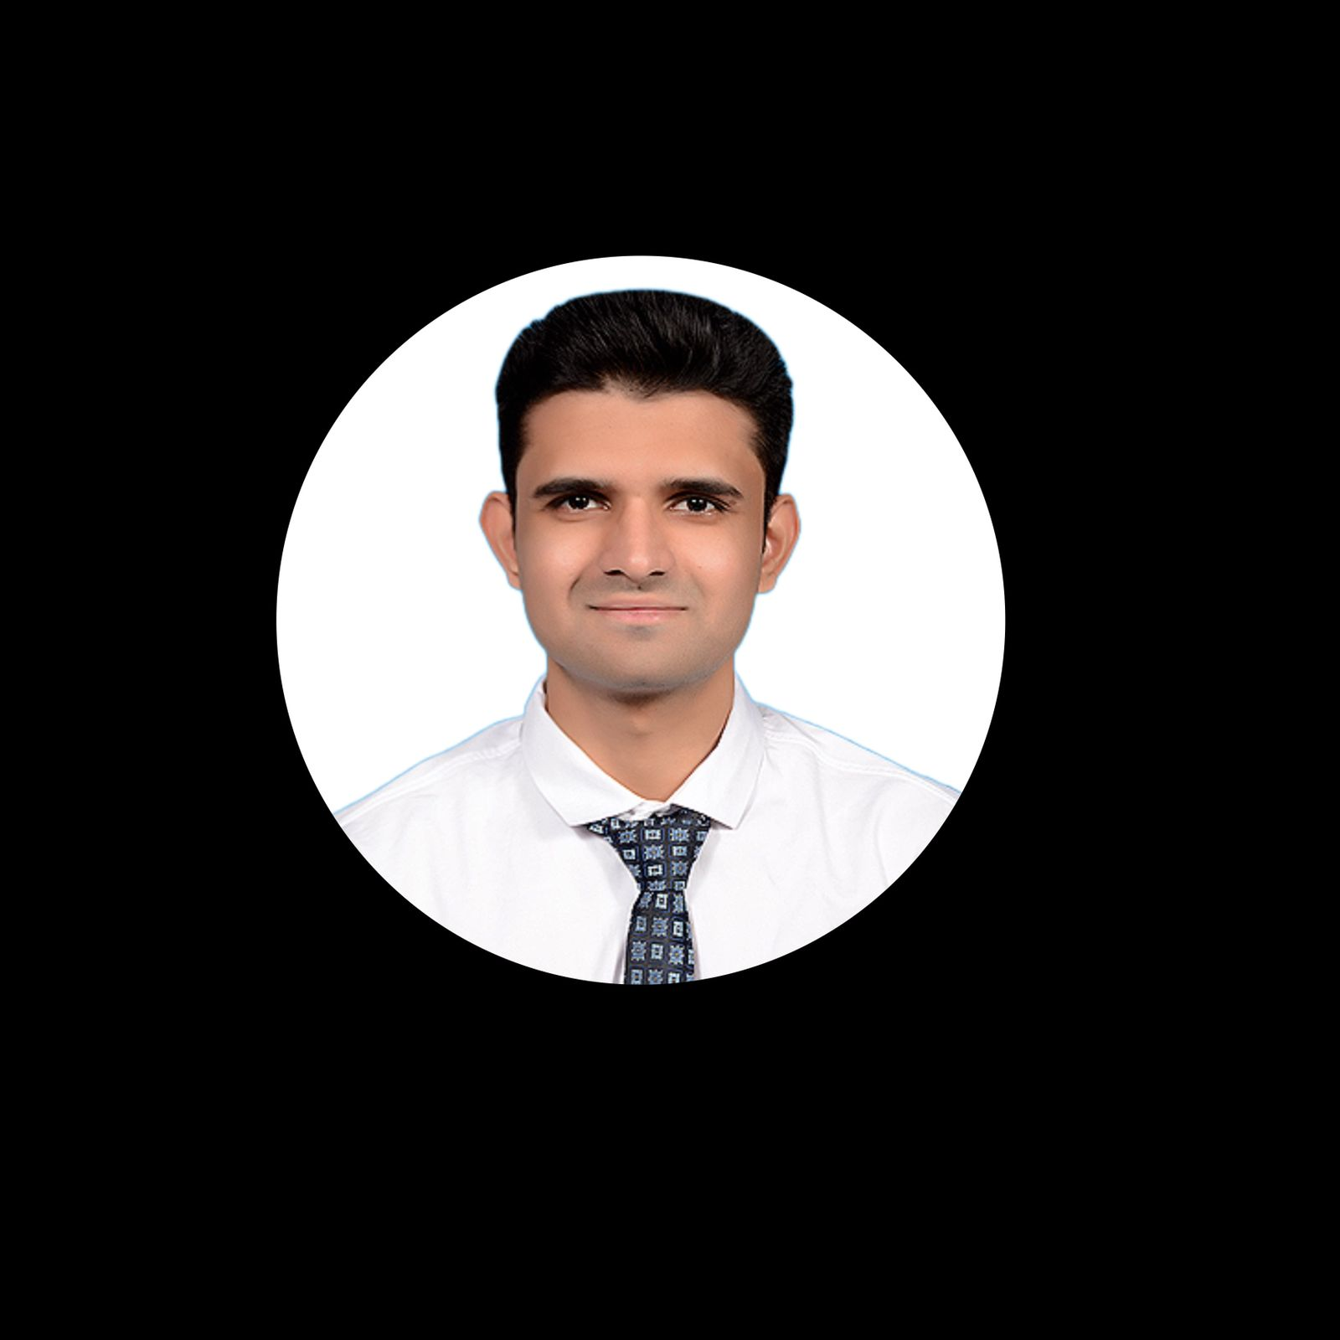



Meet our team
PRASHANT MENAKR
PRN:220360920038
PRATIK DESHMUKH
PRN:220360920039
PAWAN PATIL
PRN:220360920036
PRADNYA PAWAR
PRN:220360920037

Slide 4
Introduction
In today’s world online booking is very wide trend. With the help of this software you can book online room as yours required. The system shall take the start and end dates from the user and check for availability of rooms. It shall check for the number of guests and reserve the rooms for the user. The guests can visit the site and register themselves with the required information that is expected by the system. This tool shall enable the user to check for information regarding the hotel and reserve rooms. It enables the user to make payments online.

Slide 5
COMPARISON
Existing System:
Proposed System:
Hotel Booking Functionality:
The Reservation done offline and online till now. The customers had to call up the hotel and make bookings depending on the availability.
The information was given individually to all the customers who called for reservations. This was a difficult task.
This tool shall help the user to make reservation for hotels online. The user can check the availability of the rooms.
The tool provides an option to input start and end dates of the booking. It also takes input such as the number of guests.
Admin/Guest Login
Database for storing data
Tracks the Details of Guest.
Guest check available hotels in city.
Guest checks the availability of rooms in particular hotel at particular location.
Online Payment Gateway.

Slide 6
Functionality:
1.Admin
2.Guest

Slide 7
Admin:
Checking the Guests.
Manage Guest and Booking history.
Create a payment Receipt for Guest.
Manage own profile.

Slide 8
Guest:
Registration.
Login.
Payment

Slide 9
TECHNOLGIES USED:
FRONT-END:-
HTML
CSS
BOOTSTRAP
BACK-END:-
J2EE
JSP
SPRINGBOOT
HIBERNATE
MYSQL

Slide 10
FRONT-END TECHNOLOGY:
HTML
CSS
BOOTSTRAP
HTML stands for Hyper Text Markup Language.
HTML is the standard markup language for creating Web pages.
HTML describes the structure of a Web page.
HTML consists of a series of elements.
HTML elements tell the browser how to display the content.
HTML elements label pieces of content such as "this is a heading", "this is a paragraph", "this is a link", etc.
The syntax and forms of the language. Specificity, inheritance, and the Cascade.
CSS units and values and functional notations.
• Box model and margin collapse.
• The containing block
• Stacking and block-formatting contexts.
• Initial, computed, used, and actual values
Easy to Use.
Mobile-Friendly.
Customizable Bootstrap.
Simple Integration.•
Pre-styled Components.
Browser Compatibility.
Great Grid System.

Slide 11
BACK-END TECHNOLOGY:
J2EE
JSP
SPRINGBOOT
Platform independent.
Provide API.
Make interactive websites.
Easier to read data from user.
Easier to display server response.
Allows to add Java to your website.
Easier to connect to the database.
Tracking the user.
Easy to code
Increase productivity.
No need to XML configuration.
Reduce the length of code.
Provide security to project.

Slide 12
BACK-END TECHNOLOGY:
HIBERNATE:
MYSQL:
Lightweight.
Hibernate is a lightweight framework as it does not contains additional functionalities.
It uses only those functionalities required for object-relational mapping. Open Source.
Easy and simple to use.
Can access the data easily and changes can be made easily with the help of queries.

Slide 13
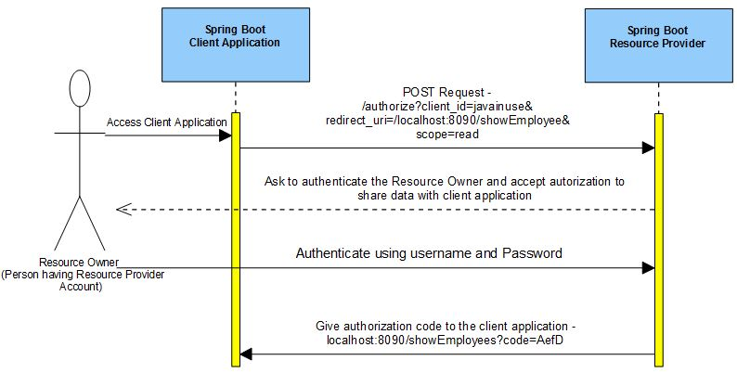
USER REGISTRATION,USER LOGIN AND AUTHORIZATION PROCESS:

Slide 14
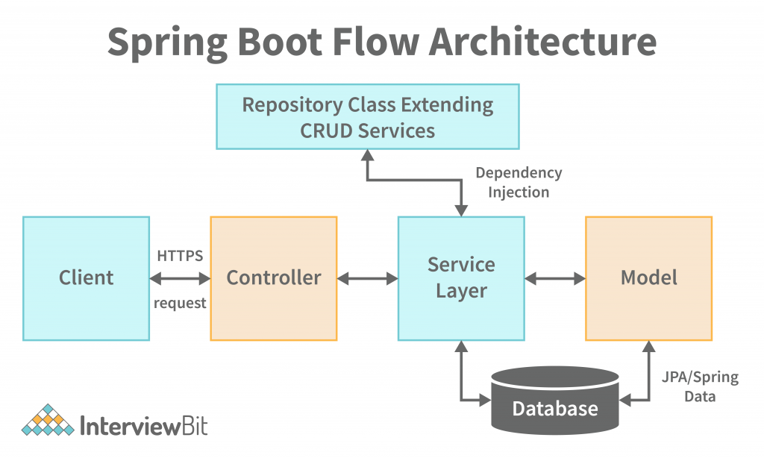
SPRING BOOT SERVER ARCHITECTURE WITH SPRING SECURITY:

Slide 15
CONCLUSION
While developing this project we have learnt a lot about hotel management,
The Online Hotel Reservation System was developed to replace the manual process of booking for a hotel room or any other facility of the hotel.
The old system does not serve the customer in a better way; rather it makes customer data vulnerable.
The new system keeps proper records of customers for emergency and security purposes.
We have learnt how to make a system user friendly. We also realized the importance of maintaining a minimal margin for error.
During the development process we studied carefully and understood the criteria of Implementation process.

Slide 16
THANK YOU

